Slide 1
Spatial Mapping in R
Tiziana Gelmi-Candusso
Mark Jordan

Slide 2


Mark Jordan
Associate Professor of Biology
Seattle University
jordanma@seattleu.edu
Tiziana Gelmi Candusso
Postdoctoral Fellow
University of Toronto
tiziana.gelmicandusso@utoronto.ca

Slide 3
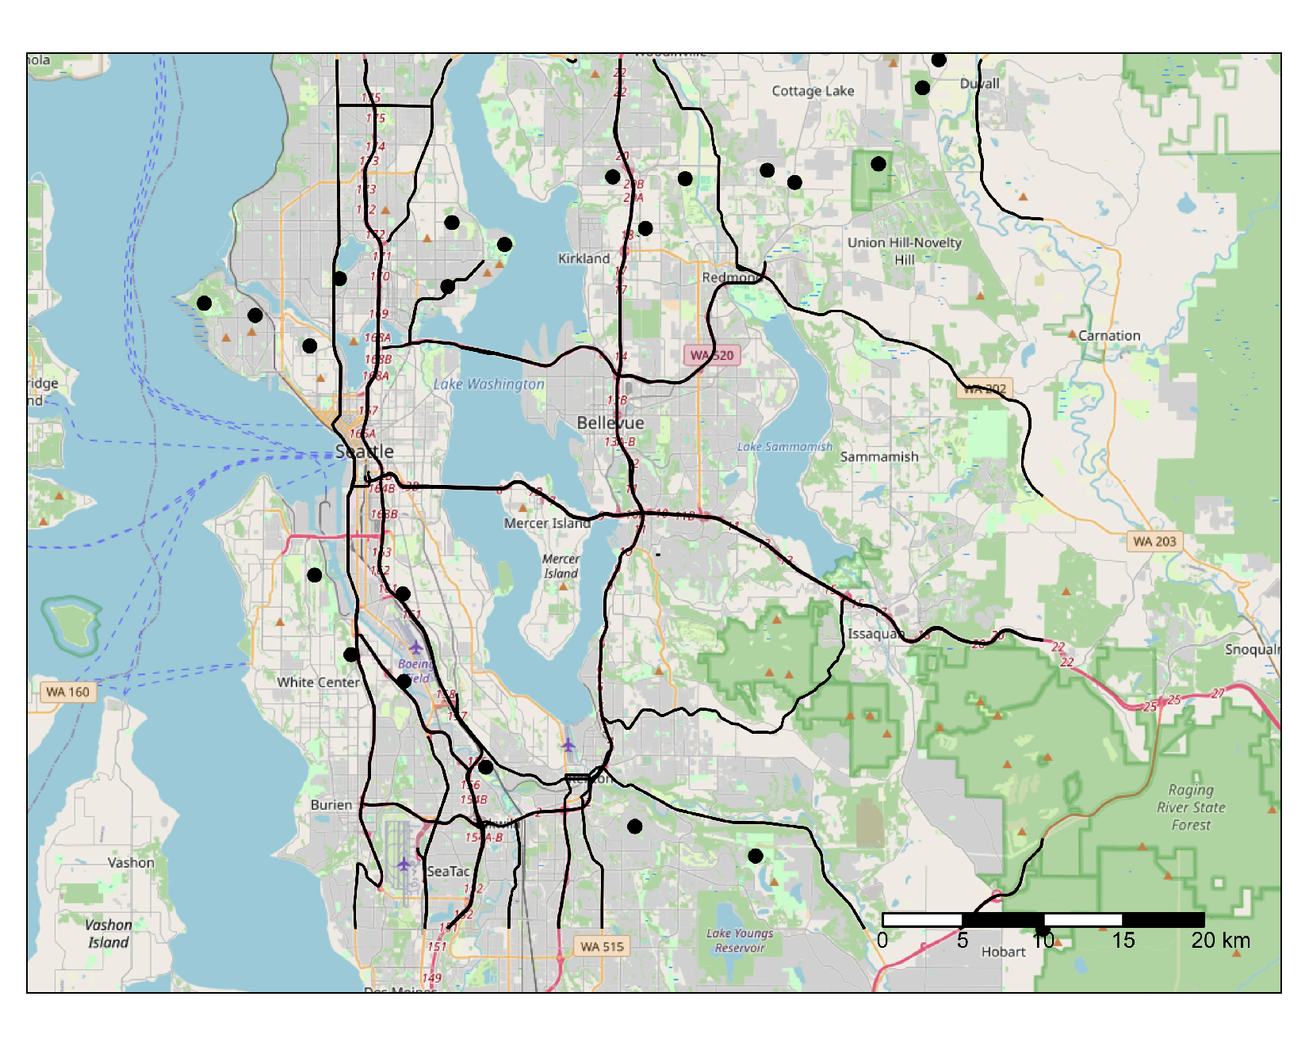
What is spatial data?
Data that references a specific geographic location
Landscape features (natural or built)
Environmental properties (temperature, air quality)

Slide 4
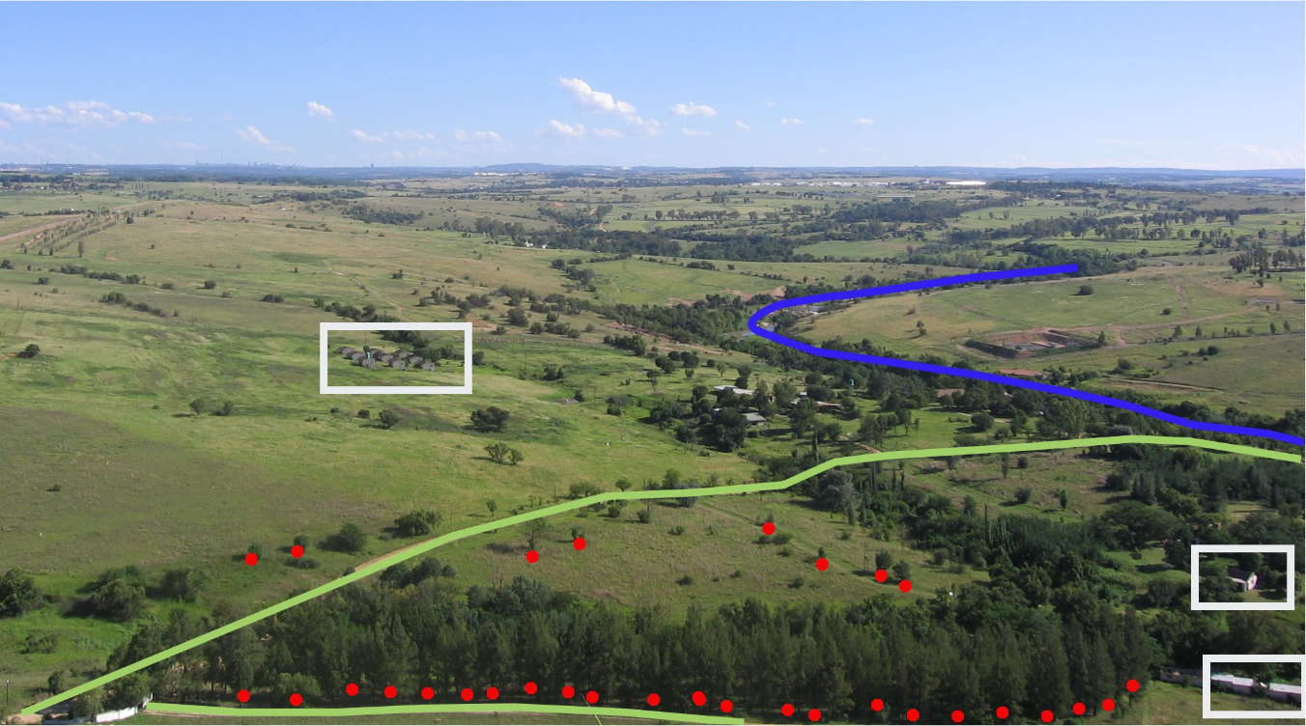
Types of spatial data - vectors
Lines
Polygons
Points

Slide 5
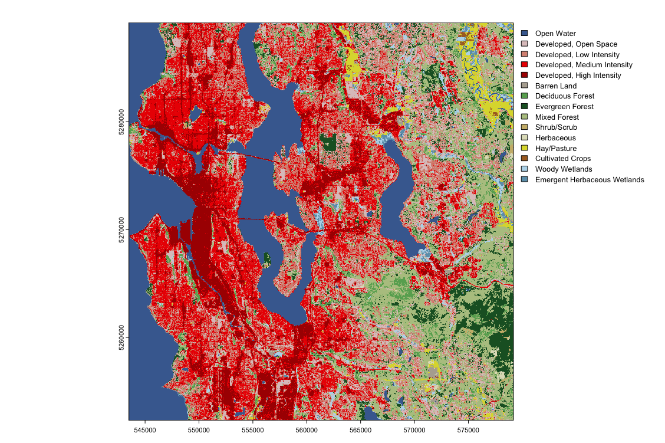
Types of spatial data - rasters

Slide 6
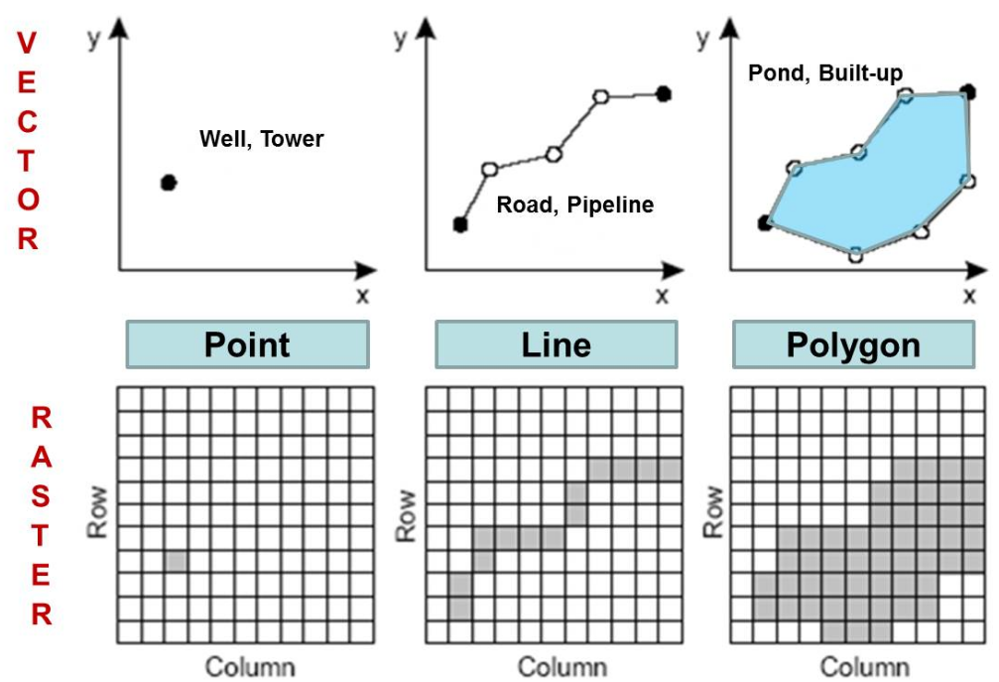
Comparison of vector and raster data

Slide 7
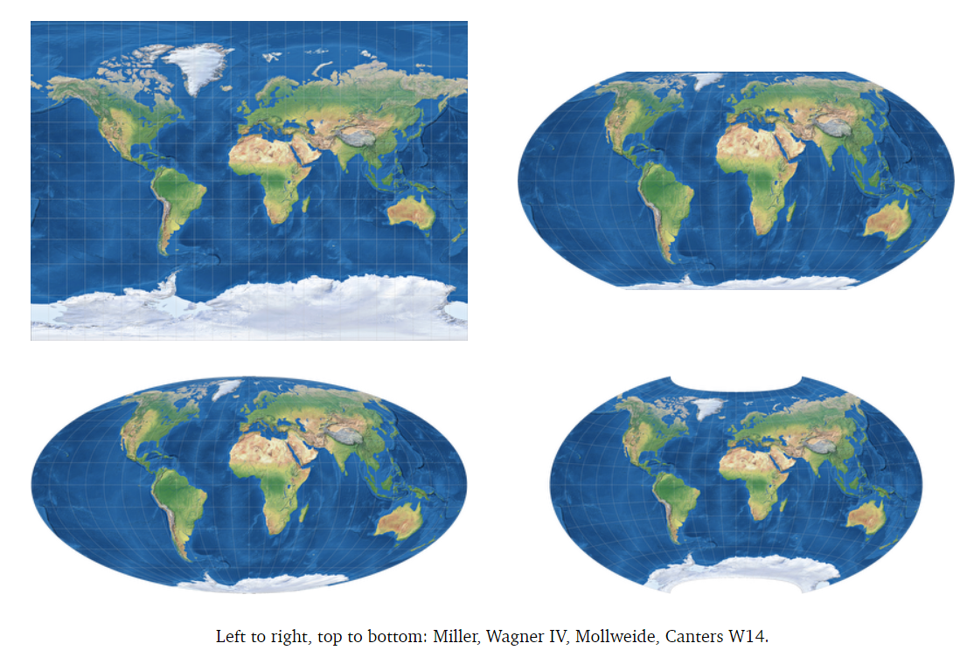
Projections and Spatial Reference Systems (SRS)
Projection - method for “flattening” the globe
SRS - combination of a projection and a coordinate system (x,y)

Slide 8
Why should you use R for spatial data?
Free and open source
Computationally faster
Save your work in a script file
All analysis in one place

Slide 9

Setting up to use R with your spatial data
Packages: sf and terra
sf: traditional method for working with vector data
terra: newer, handles both vector and raster data
Other useful packages
dplyr, ggplot, and the rest of the tidyverse
Other mapping packages: rosm, tmap, leaflet
Function equivalents between packages linked in tutorial

Slide 10

Tutorial outline - mapping camera trap data
Background information
Vector data
Points: camera trap results
Lines: roads
Polygons: forest cover
Raster data: NDVI and built environment
Downstream analysis of processed spatial data
Spatial analysis skills
Importing data
Re-projecting data
Making maps
Analyzing data

